Slide 1


Slide 2
Status epilepticus

Slide 3
Definitions
The classical definition: SE requires that seizures (continuous or intermittent without return to baseline mental status) last for a minimum of 30 minutes
seizures which last longer than 5 minutes are unlikely to stop spontaneously and may be referred to as impending SE

Slide 4
Definitions
SE presents as a seizure that lasts longer than expected
ILAE defines: a seizure that shows no clinical signs of arresting after a duration encompassing the great majority of seizures or recurrent seizures without interictal resumption of baseline central nervous system function
The incidence is highest in children younger than 1 year

Slide 5
Definitions
The ILAE has refined the definition of SE to reflect the time at which treatment should be initiated (t1 ) and time at which continuous seizure activity leads to long-term sequelae (t2 ) such as neuronal injury, depending on the type of SE

Slide 6
Definitions
For generalized tonic-clonic seizures, SE is defined as continuous convulsive activity or recurrent generalized convulsive seizure activity without regaining of consciousness (t1 = 5 min, t2 ≥ 30 min). The definition differs for SE consisting of focal seizures with impaired awareness (t1 = 10 min, t2 = 30 min) and absence SE (t1 = 10-15 min, t2 = unknown).

Slide 7
Definitions
Nonconvulsive status epilepticus manifests as a confusional state, dementia, hyperactivity with behavioral problems, fluctuating impairment of consciousness with at times unsteady sitting or walking, fluctuating mental status, confusional state, hallucinations, paranoia, aggressiveness catatonia, and or psychotic symptoms

Slide 8
Definitions
fever-induced refractory epileptic encephalopathy in school age children (FIRES), is a syndrome of refractory SE that is associated with acute febrile infections, appears to be parainfectious in nature, and appears to be highly drug resistant but is often responsive to the Ketogenic diet

Slide 9
ETIOLOGY
Most episodes of SE begin in previously healthy children in the out-of-hospital setting
The most common etiology of pediatric SE is febrile/infectious followed by other acute symptoma tic causes (metabolic, low antieseizure drug levels,…)
Genetic factors might promote or protect patients from developing prolonged seizures

Slide 10
CLINICAL PRESENTATION
Regardless of the etiology and type, SE represents a lifethreatening emergency that should be managed rapidly
Generalized tonic-clonic SE is associated with intense muscle activity with the consequent metabolic and cardiovascular demands
Focal seizures are associated with less metabolic demands but are equally harmful to the brain if sustained in time

Slide 11
INITIAL MANAGEMENT
The initial therapy for SE includes:
Maintenance of adequate brain oxygenation and cardiorespiratory function
Identification and correction of seizure triggers such as hypoglycemia, electrolyte imbalance, lowered drug levels, infection, and fever
Prevention of systemic complications

Slide 12
TIME TO TREATMENT
There are three major determinants of prognosis in SE: age, etiology, and SE duration
A delay of more than 30 minutes in administering the first antiseizure drug was associated with worse response to treatment
An early and appropriate treatment may markedly reduce the duration and improve patient outcomes

Slide 13
Status Epilepticus Guideline
Treatment Algorithm for Status Epilepticus for Children Older than Neonates

Slide 14
0-5 min (Stabilization Phase)

Slide 15
5-10 min (First Therapy Phase)

Slide 16
10-30 min (Second Therapy Phase)

Slide 17
>30 min (Third Therapy Phase)

Slide 18
Patient Should be Intubated

Slide 19

NEONATAL STATUS EPILEPTICUS

Slide 21
NEONATAL STATUS EPILEPTICUS
Because neonatal seizures typically reflect an underlying functional or structural lesion, the mortality and morbidity burdens are typically higher than in older children
Diagnosis of neonatal seizures is challenging because many repetitive neonatal movements do not have an ictal EEG correlate and many electrographic seizures do not have associated clinical manifestations

Slide 22
NEONATAL STATUS EPILEPTICUS
Antiseizure medicines may stop clinical seizures although seizures persist on EEG, a phenomenon termed “electroclinical uncoupling”
Therefore clinical observation alone may yield false positives (nonictal movement leads to administration and escalation of therapies) and false negatives (EEG seizures go undetected and thus untreated)

Slide 23
NEONATAL STATUS EPILEPTICUS
In the guideline of the American Clinical Neurophysiology Society (ACNS): conventional video-EEG monitoring is the gold standard for neonatal seizure
The definition of SE in newborns is not as straightforward as in older children or adults

Slide 24
NEONATAL STATUS EPILEPTICUS
There is no consensus on the definition of SE in newborns to be present when more than 50% of a 1-hour EEG epoch contains seizures, which may be a single continuous 30-minute seizure or a series of briefer seizures totaling 30 minutes

Slide 25
NEONATAL STATUS EPILEPTICUS
Regardless of how SE is defined in newborns, a higher seizure burden is associated with less favorable outcomes, even after controlling for potential confounders
Regarding treatment of neonatal seizures and neonatal SE, phenobarbital and phenytoin remain the preferred choices

Slide 26
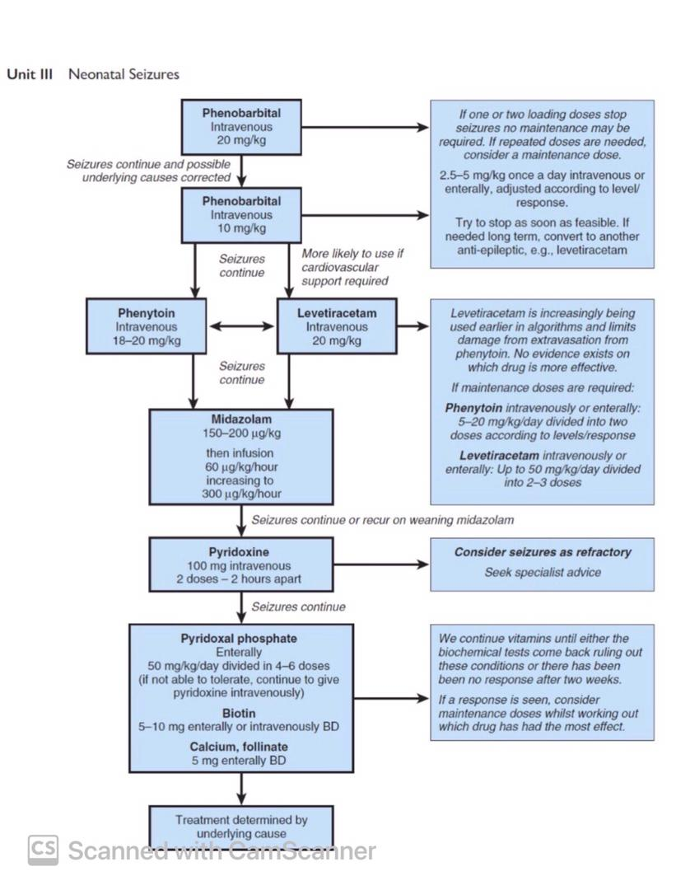

Slide 28
NONCONVULSIVE STATUS EPILEPTICUS

Slide 29
NONCONVULSIVE STATUS EPILEPTICUS
NCSE refers to prolonged seizure activity in the absence of major motor signs or to a change in behavior and/or mental processes from baseline associated with continuous epileptiform discharges in the EEG
Patients with developmental delay, recurrent seizures on multiple medications, and/or critically ill patients are at high risk for developing NCSE

Slide 30
NONCONVULSIVE STATUS EPILEPTICUS
NCSE can be broadly classified into subcategories:
Absence NCSE
Complex partial NCSE
NCSE in coma

Slide 31
Absence NCSE
Consists of a prolonged state of drowsiness and confusion in which agitation, violent behavior, and hallucinations
The EEG shows generalized abnormalities markedly different from the interictal state
Subtle myoclonic movements sometimes occur within this category

Slide 32
Complex partial NCSE
Consists of periods of abnormal behavior or abnormal cognitive state including amnesia, aphasia, or hemiparesis in between complex partial seizures
EEG findings are focal with preferential involvement of the temporal and frontal lobes and include spike and wave, polyspikes, and rhythmic slowing

Slide 33
NCSE in coma
Consists of prolonged or recurrent electrographic seizures in patients in coma
A prior diagnosis of epilepsy and/or the presence of interictal epileptiform activity on EEG were identified as risk factors for the occurrence of electrographic seizures
Some children with NCSE would have been undetected without EEG monitoring

Slide 34


Thanks For Your Attention

