Slide 1
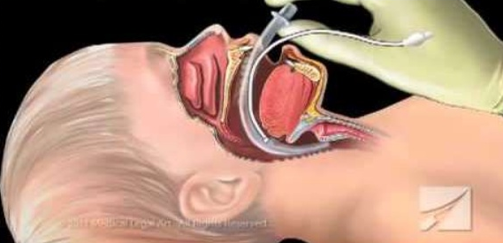
Pediatric Airway Management
Presented By:
Dr. N. Abootalebi
Pediatrician, Pediatric Intensivist

Slide 2
Case Scenario
6 m/o infant , down syndrome, presented with URI manifestations that followed by respiratory distress and intercostal retraction and subcostal retraction.
O2 with non-rebreathable mask 10 liter/ min
P/E: PR: 130 RR:52 T:38 BP:85/60
O2 sat: 85%
ABG: PH:7.34 Pco2: 42 Po2: 50 HCO3: 27

Slide 3
Anatomical difference between adult and pediatric
Nose
Obligatory nasal breathing
Poor tolerance to obstruction
Head
Relatively large
Tongues
Large
Loss of tone with sleep, sedation, CNS dysfunction
Notes:
Mouth and nose - generally all structures are smaller and more easily obstructed than in adults.
Pharynx - infant’s and children’s tongues take up proportionally more space in the mouth than adults.
Trachea - (windpipe)
Infants and children have narrower tracheas that are obstructed more easily by swelling.
Trachea is softer and more flexible in infants and children
Cricoid cartilage - like other cartilage in the infant and child, the cricoid cartilage is less developed and less rigid. It is the narrowest part of the infant’s or child’s airway

Slide 4
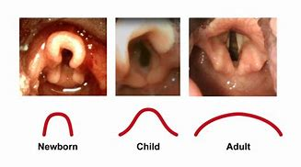
Anatomical difference between adult and pediatric
Epiglottis
Relatively large size in children
Omega shaped
Floppy – not much cartilage

Slide 5
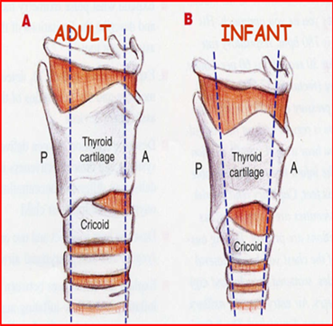
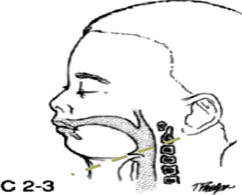
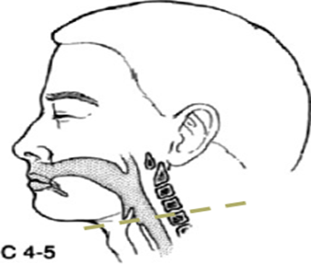
Anatomical difference between adult and pediatric
Larynx
High position
Anterior position
Funneled shape

Slide 6
Anatomical difference between adult and pediatric
Cricoid cartilage
less developed and less rigid
The narrowest part of airway
Fully developed cricoid cartilage occurs at 10-12 years of age
Trachea
Narrower and more flexible

Slide 7
Airway Evaluation Medical History
URI
predisposes to coughing, laryngospasm, bronchospasm,during anesthesia
Snoring or noisy breathing
adenoidal hypertrophy, upper airway obstruction
Chronic cough
subglottic stenosis, previous TE fistula repair
Productive cough
bronchitis, pneumonia

Slide 8
Airway Evaluation Medical History
Sudden onset of new cough
foreign body aspiration
Inspiratory stridor
macroglossia, laryngeal web, laryngomalacia
Hoarse voice
laryngitis, vocal cord palsy, papillomatosis

Slide 9
Airway Evaluation Medical History
Asthma and bronchodilator therapy
Bronchospasm
Repeated pneumonia
GERD, CF, bronchiectasis, TE fistula, immune suppression, congenital heart disease
Previous anesthetic problems
difficulty intubation/extubation or difficulty with mask ventilation

Slide 10
Airway Evaluation Physical Exam
Facial expression
Nasal flaring
Mouth breathing
Drooling
Retraction
suprasternal, intercostal or subcostal
Respiratory rate
Voice change
Color of mucous membranes
Size of mouth
Loose/missing teeth
Baseline O2 saturation

Slide 11
Monitoring respiratory function
Longitudinal physical assessment
Arterial blood gas
Hypoventilation
Hyperventilation
Metabolic acidosis
Pulse oximetry
Exhaled carbon dioxid
dependent on 3 variables:
CO2 production
Delivery of blood to lungs & the lungs ability to exchange gas
Alveolar ventilation

Slide 12
Signs of Impending Respiratory Failure
Increase work of breathing
Tachypnea/tachycardia
Nasal flaring
Drooling
Grunting
Wheezing
Stridor
Use of accessory muscles/retraction
Cyanosis despite O2
Irregular breathing/apnea
Altered consciousness/agitation
Inability to lie down

Slide 13
Indications for definite airway
Inadequate oxygenation
Low O2, <60
Inadequate ventilation
High CO2, >50
Inadequate protection
Airway Malformations
Airway trauma
Decrease level of conscious
other
Clinically
Other organ support such as heart failure
Long transports

Slide 14
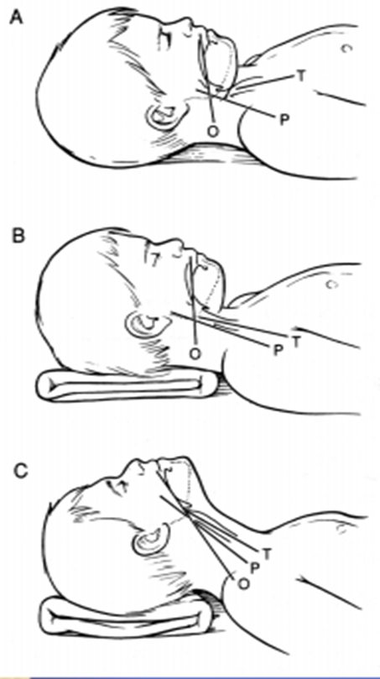
Sniffing Position
Patient flat on operating table, the oral (o),
pharyngeal (P), and tracheal (T) axis pass through
three divergent planes
A blanket placed under the occiput aligns the
pharyngeal (P) and tracheal (T) axes
Extension of the atlanto-occipital joint
aligns the oral (O), pharyngeal (P), and
tracheal (T) axes

Slide 15
Sniffing Position

Slide 16
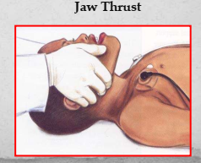

Slide 17
Head Tilt Chin lift maneuver
Notes:
Radiology studies have shown that head extension is the most important single maneuver for maintaining space between the pharyngeal soft tissues,,, Head extension stretches the anterior neck structures and moves the hyoid bone and attached structures anteriorly,,, In patients with an unstable cervical spine, head extension should be used only if all other airway maneuvers fail to overcome the airway obstruction

Slide 18
Nasal cannula
Delivers humidified oxygen
Nasal passages must be patent
Max flow rate : 5L/min
Approximate FIO2 : 25-50%

Slide 19
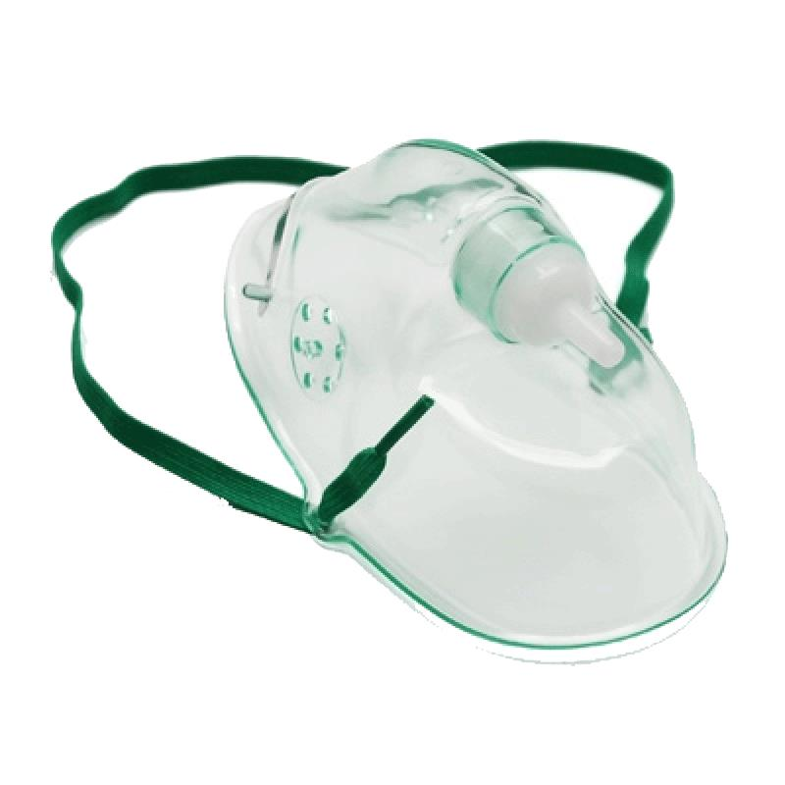
Simple oxygen mask
Delivers humidified oxygen
Minimum flow rare : 5 L/min ( to clear exhaled CO2 from mask )
Approximate FIO2 : 35-60%

Slide 20
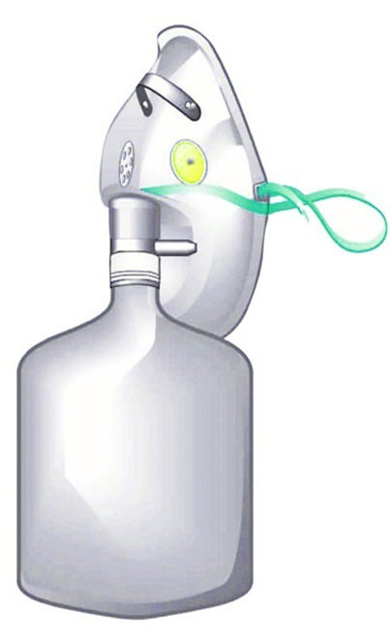
Non-rebreathing mask
Delivers non - humidified oxygen
Used for emergency delivery
Minimum flow rare : 10 L/min
Approximate FIO2 : 80-100%
Reservoir bag provides 100% Fio2
and minimizes room air dilution

Slide 21
Venturi mask

Slide 22
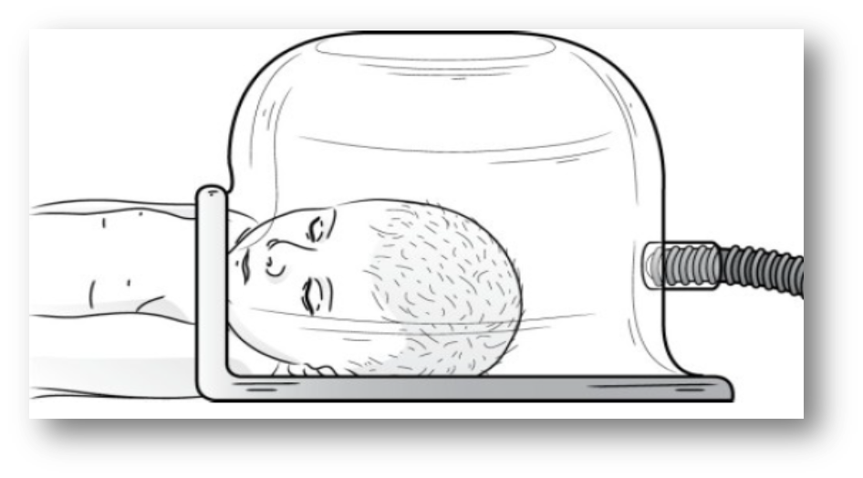
Oxyhood
Delivers heated , oxygen to patients with Wt<15kg
Fio2 range : 50-80 %
Minimum flow rate : 10 L/min

Slide 24
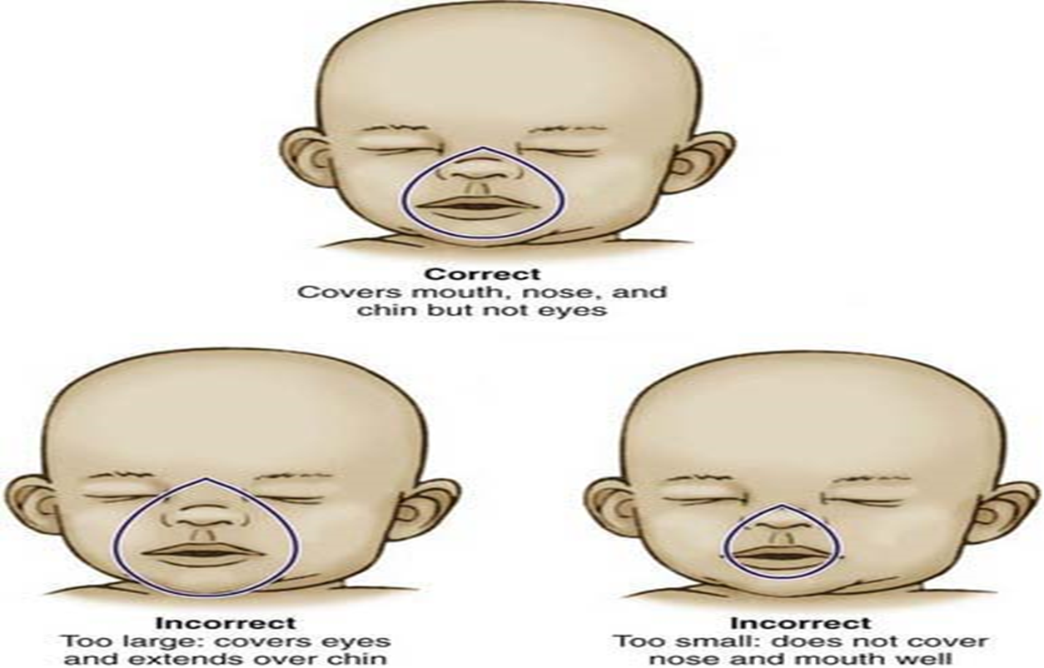
Bag-Mask Ventilation
Proper area for mask application-bridge
of nose extend to chin
Maintain airway pressures <20 cm H2O
Place fingers on mandible to
avoid compressing pharyngeal space

Slide 29
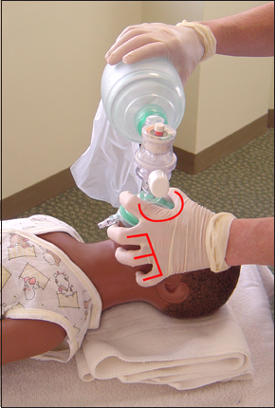

Slide 30
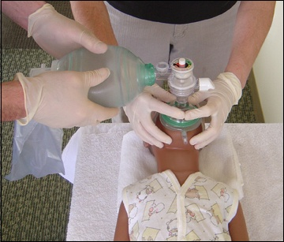

Slide 31
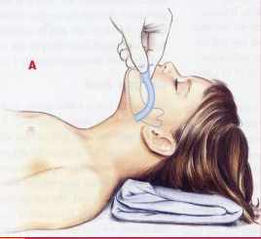
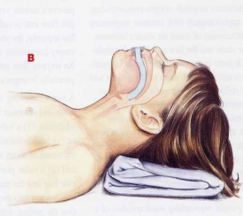
Oropharyngeal Airway

Slide 32
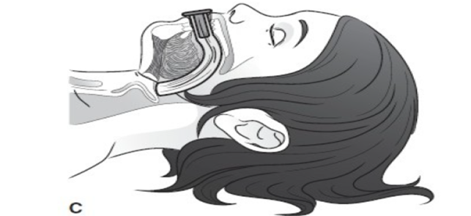
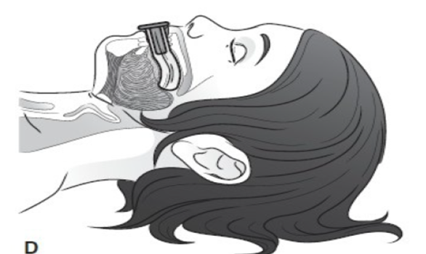
Oropharyngeal Airway Placement

Slide 33
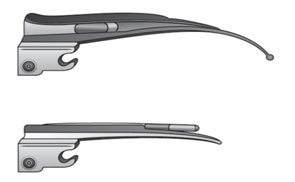
Selection of laryngoscope blade:
Miller blade
preferred for infants and younger children
Facilitates lifting of the epiglottis and exposing the glottic opening
Macintosh blades
generally used in older children

Slide 34
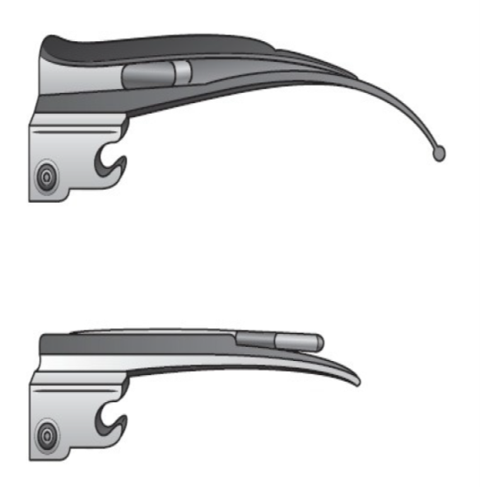
Selection of laryngoscope blade:
Blade size dependent on body mass of the patient and the preference of the anesthesiologist
Care must be taken to avoid using the blade as a fulcrum with pressure on the teeth and gums

Slide 35
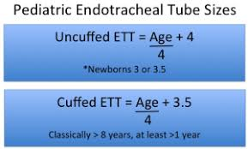
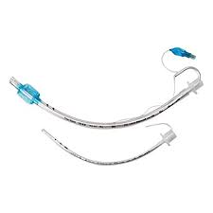
Endotracheal Tube

Slide 36
Complications of Endotracheal Intubation
Postintubation Croup
Incidence : 0.1-1%
Risk factors:
large ETT
change in patient position
multiple attempts at intubation
traumatic intubation
Tx:
nebulized racemic epinephrine
steroid

Slide 37
Complications of Endotracheal Intubation
Subglottic Stenosis
Occurs in of prolonged endotracheal intubation
Lower incidence in preterm infants and neonates due to relative immaturity of cricoid cartilage
Pathogenesis:
ischemic injury secondary to lateral wall pressure from ETT edema
Necrosis
ulceration of mucosa
Granulation tissues form
scarring and stenosis

Slide 38
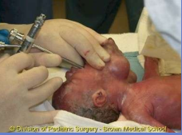
Congenital Neck Masses

Slide 39
Congenital Syndromes Pierre Robin Sequence

Slide 40
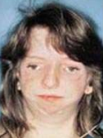

Slide 41
Congenital Syndrome Down’s Syndrome

Slide 42
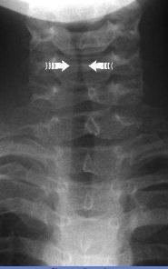
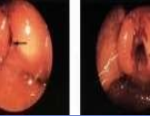
Inflammatory

Slide 44
The Six ‘P’s of RSI(Rapid Sequence Intubation)
Preparation
Pre-Oxygenation with 100% oxygen
Pretreatment & Induction
Paralysis + Cricoid pressure
Placement of the tube
Post intubation management & strategy of failed intubation

Slide 45
PREPARATION
Assess patient
Any features of difficult intubation?
IV Access
Adequate & Functioning
Monitor
Pulse oximeter
BP Q 5 min
Heart monitoring

Slide 46
PREPARATION
Optimal positioning
Other:
Equipment for intubation
RSI drugs
Post intubation medication
Vasopressor
Maintenance of sedation and paralysis

Slide 47
PREPARATION
Prepare team
Intubation
Drugs
Cricoid pressure
In-line stabilisation ( C-spine injury )

Slide 48
Pre-Oxygenation
Goals:
Establish O2 reservoir
Maximize time for intubation
Prevent need for bag-mask ventilation
Methods:
3-5 minutes of 100% O2 via face mask
5 Tidal capacity (5 Breaths)

Slide 49
Pre-Treatment
Goals:
Mitigate adverse physiologic reactions to intubation
Sympathic “pressor response” to Manipulation of airway
↑ HR/BP
Bronchospasm
Increased ICP
Muscle Fasciculation
Begins 2-3 minutes prior to induction/Paralysis

Slide 50
Pre-Treatment
Lidocaine:
Dose : 1.5 mg/kg
To prevent rise ICP by
Prevent cough
Blunting pressor response
May reduce reactive bronchospasm in asthma

Slide 51
Pre-Treatment
Atropine :
Dose : 0.02 mg /kg
To prevent bradycardia caused by airway manipulation
Usually used in pediatric

Slide 52
Pre-Treatment
Opioid:
Fentanyl 3 mic/kg
Provides analgesia and reduces anxiety
Lessen pressor response:
Limits rise ICP
More effective than lidocaine

Slide 53
INDUCTION
Given as rapid IV push immediately before paralysing agent
Should provide a rapid onset & rapid recovery from anesthesia with minimal CVS & Systemic side effect

Slide 54
INDUCTION
Thiopental : 1-3mg/kg
Fentanyl : 2-5mic/kg
Midazolam : 0.2-0.5mg/kg
Ketamine : 1-2mg/kg
Propofol : 1-2mg/kg

Slide 55
Paralysis/NMB Agent
Rapid onset of action to minimize risk of aspiration & hypoxia
Minimal hemodynamic & systemic effect

Slide 56
Cricoid Pressure (sellick maneuver):
The esophagus is occluded by extension of the neck & application of pressure over the cricoid cartilage on the body of 5th cervical vertebra to obliterate esophageal lumen
Applied an assistant with thumb & finger at either side of cricoid cartilage
Maintain until after intubation & cuff inflation

Slide 57
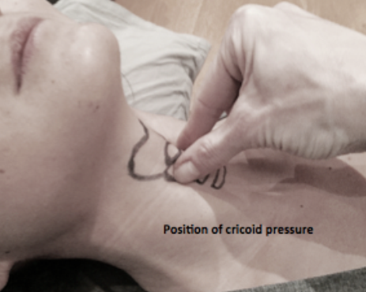
Cricoid Pressure:

Slide 58
Prepare for difficulty
Prepare for difficult airway
VDO laryngoscope
LMA
Cricothyroidotomy
Oxygenation plan in event of failed intubation

Slide 59
Laryngeal Mask Airway
Supraglottic airway device
most common pediatric indications for LMA
Flexible bronchoscopy, radiotherapy, radiologic procedures, urologic, orthopedic, ENT and ophthalmologic cases
Useful in difficult airway situations
Disadvantages: Laryngospasm, aspiration

Slide 61
Laryngeal Mask Airway

Slide 62
SOAPME
Suction equipment:
catheters, regulator/canister/tubing
Oxygen
O2 flowmeter, preoxygenate 2-3 min, manual resuscitator bag with mask
Airway equipment
ETT, stylet, syringe (cuffed ETT),laryngoscope and blade, lubricating gel, OPA
Position, pharmacy, personnel
supine, rolls for position,bed height up
Monitors
ETCO2 detector

Slide 64
Case Scenario
6 m/o infant , down syndrome, presented with URI manifestations that followed by respiratory distress and intercostal retraction and subcostal retraction.
O2 with non-rebreathable mask 10 liter/ min
P/E: PR: 130 RR:52 T:38 BP:85/60
O2 sat: 85%
ABG: PH:7.34 Pco2: 42 Po2: 50 HCO3: 27

Slide 65
Case Scenario
A 15 years old female arrived to ED by ambulance after ingestion of 6 tablets of diazepam for committing suicide after failure in the exam, she is not responding to painful stimuli, RR 27 c/min but with retraction and noisy breathing.
What is the emergency problem in this case?
What is the management?
What is the important points in the assessment?

Slide 66
Case Scenario
You are called to a 7 month old boy with respiratory syncytial virus bronchiolitis, child is alert and interactive, pink, but has retractions.
 What signs and symptoms indicate airway instability?
 Is there airway instability in this case?
 What intervention?

